Slide 1
AmanoOne Platform/Project Overview
Tim Grannen

Slide 2


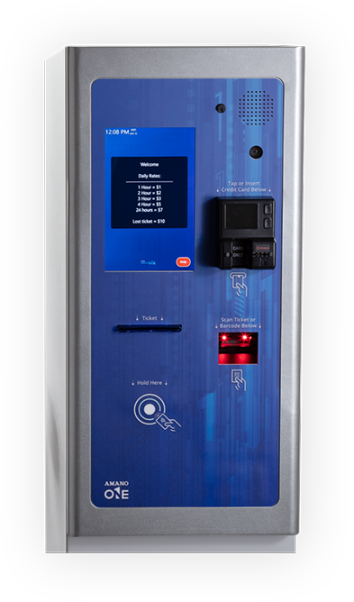
What is AmanoOne?
Cloud-based multi-tenant Parking Access and Revenue Control System
Features
Real-time device & parker monitoring
Integrated call center
Automatic software updates
License Plate Recognition
Mobile Pay
Flexible Parking Accounts
Accelerated processing and transaction speeds
Notes:
New Amano ONE Software
Interactive Reporting
Flexible Parking Accounts
Multi- Credential Access
Built-In Call Center
System Alerts and Notifications
Powerful API Library
Multi-Tenant Management
New Amano ONE Hardware
Plug-and-play hardware components for easy service
One moving part = less downtime and maintenance
Built-in call center
Mobile pay for customer convenience
Accelerated processing and transaction speeds
Ticket issue speeds as fast as .5 seconds
Designed for high-volume throughput

Slide 3

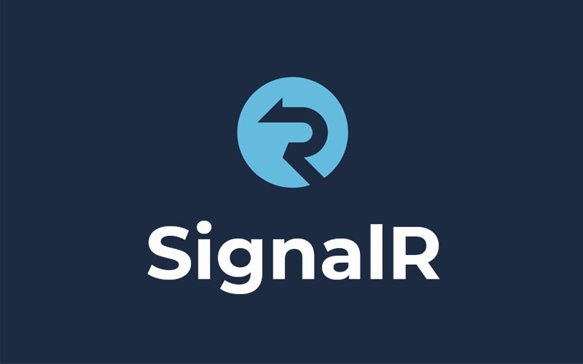










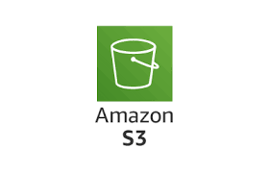





Technology/Services

Slide 4
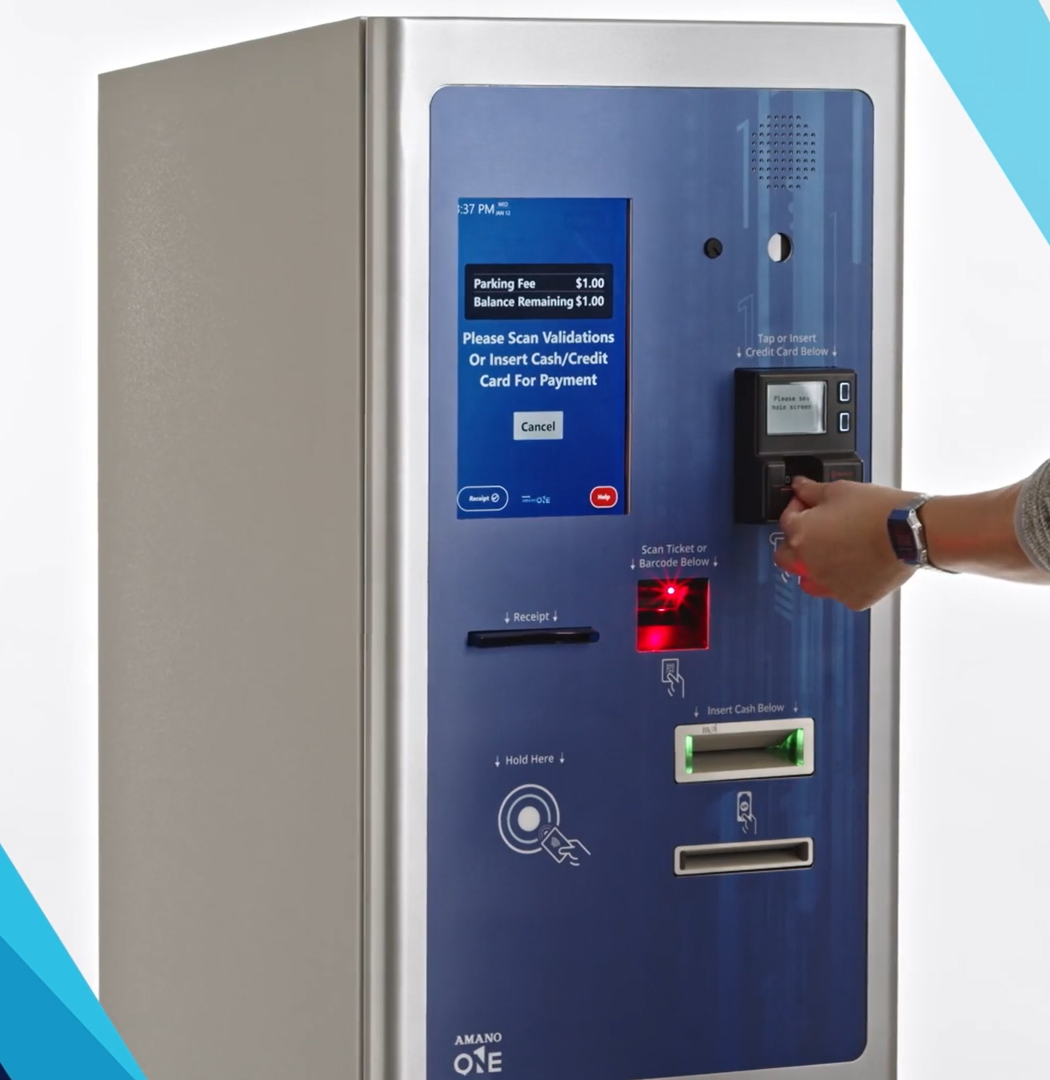
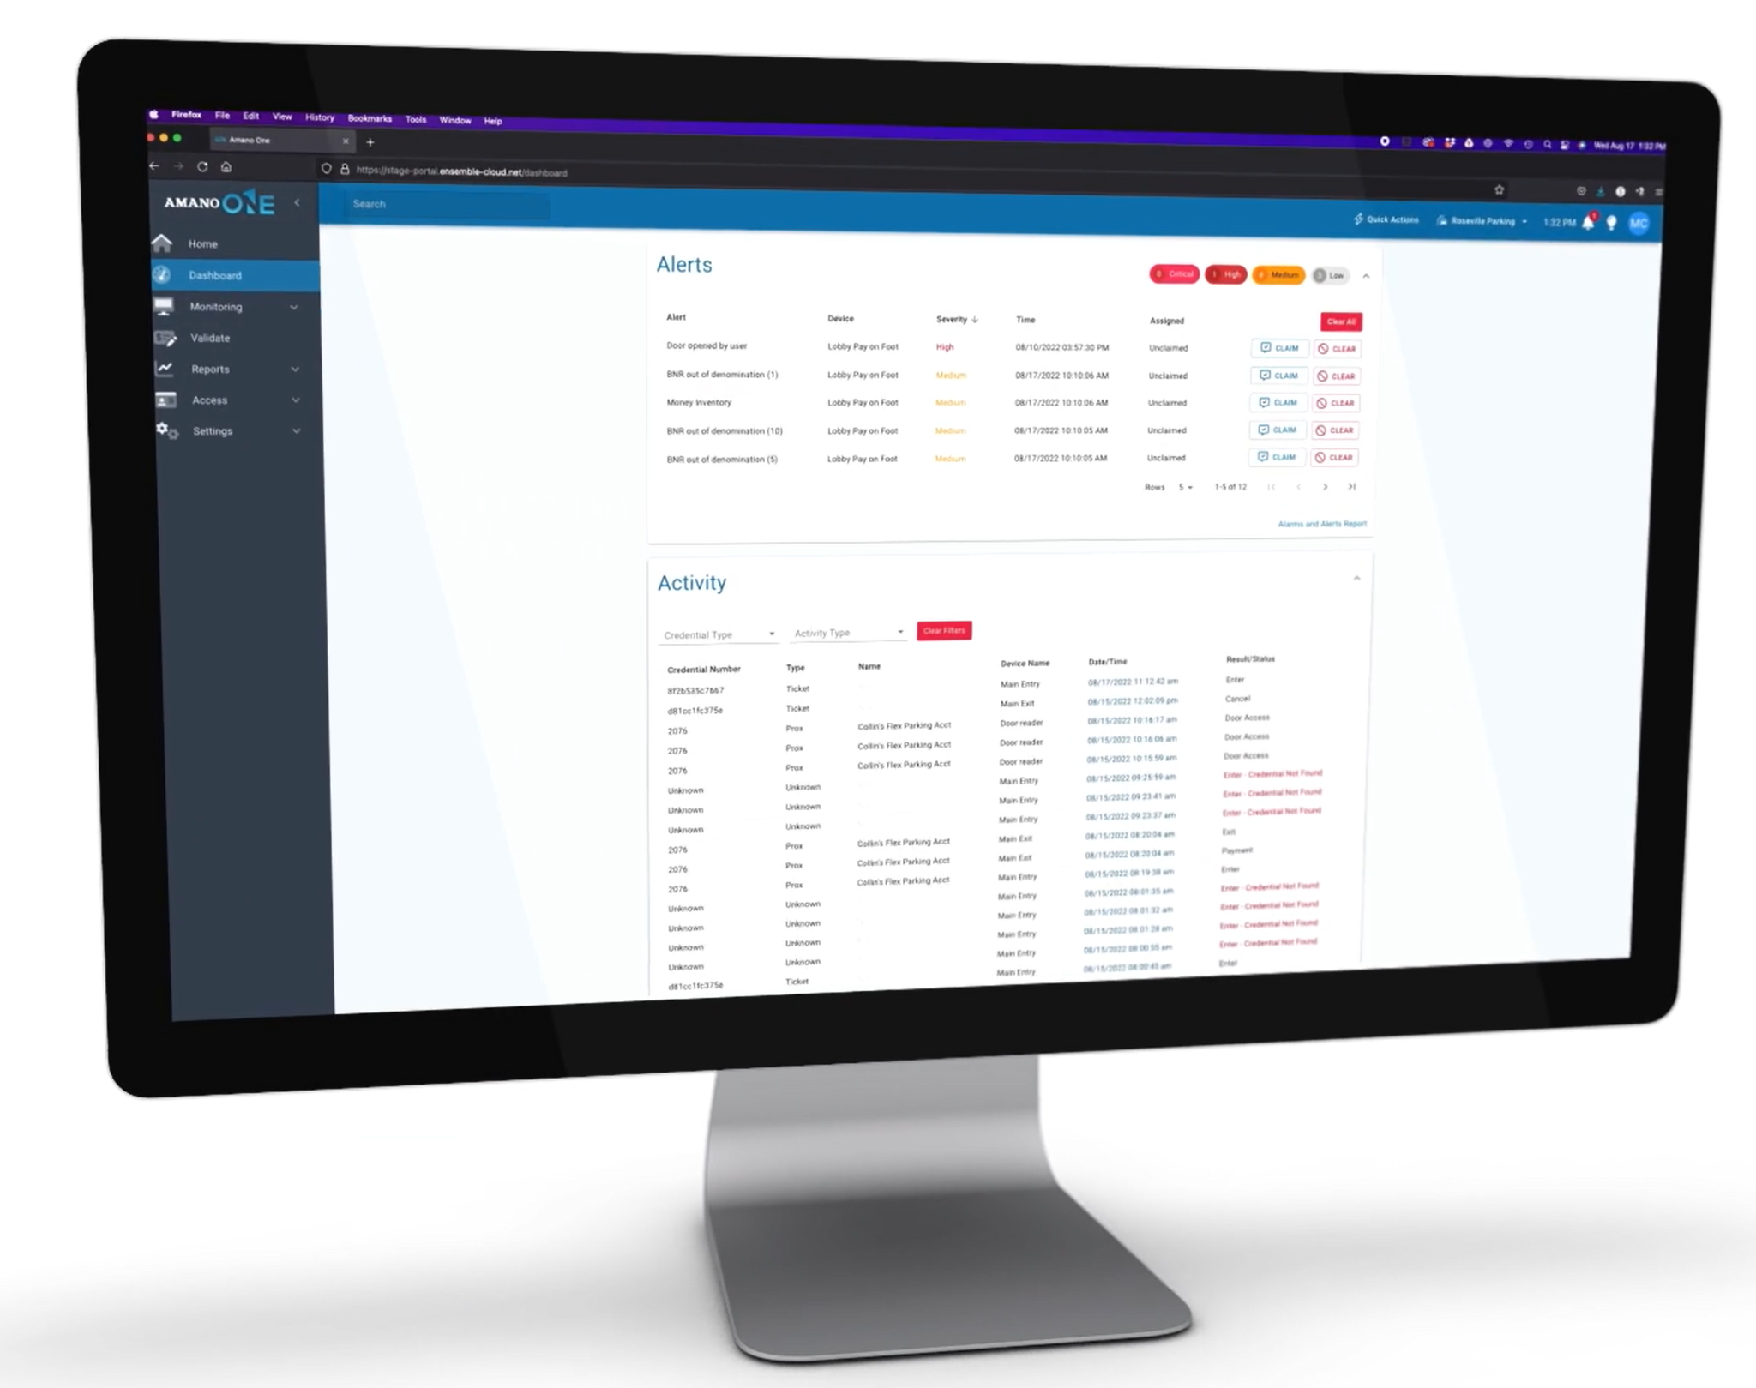
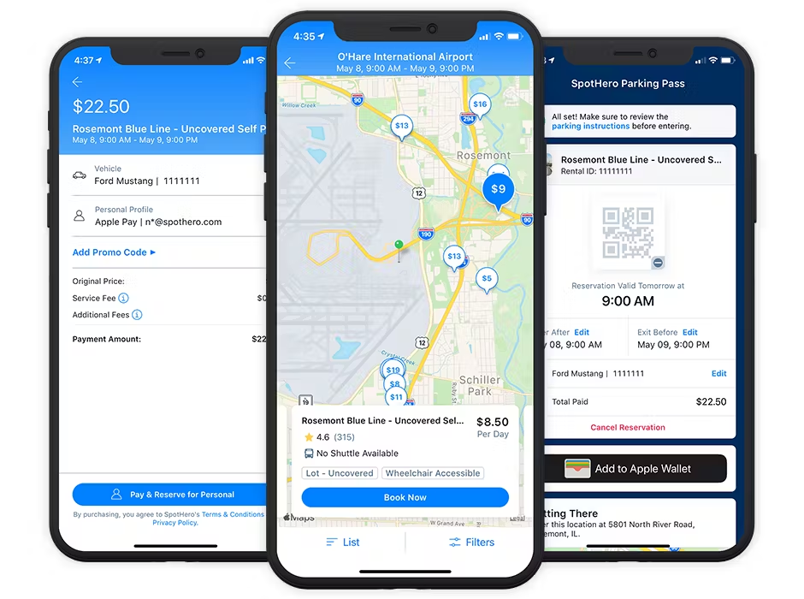
User Interfaces
Parking Devices
User Portal
Third-Party Access API
Entry, Exit, Pay on Foot, Door, Hotel interface
Parking Facility Admin, Validation users, Mobile Pay
Park Mobile, Spot Hero, etc.
Notes:
Parking Devices
Entry, Exit, Pay on Foot, Door, Hotel interface
Admin Portal
Parking Facility Admin
Validation users
Mobile Pay
Third-Party access API
Park Mobile, Spot Hero

Slide 5
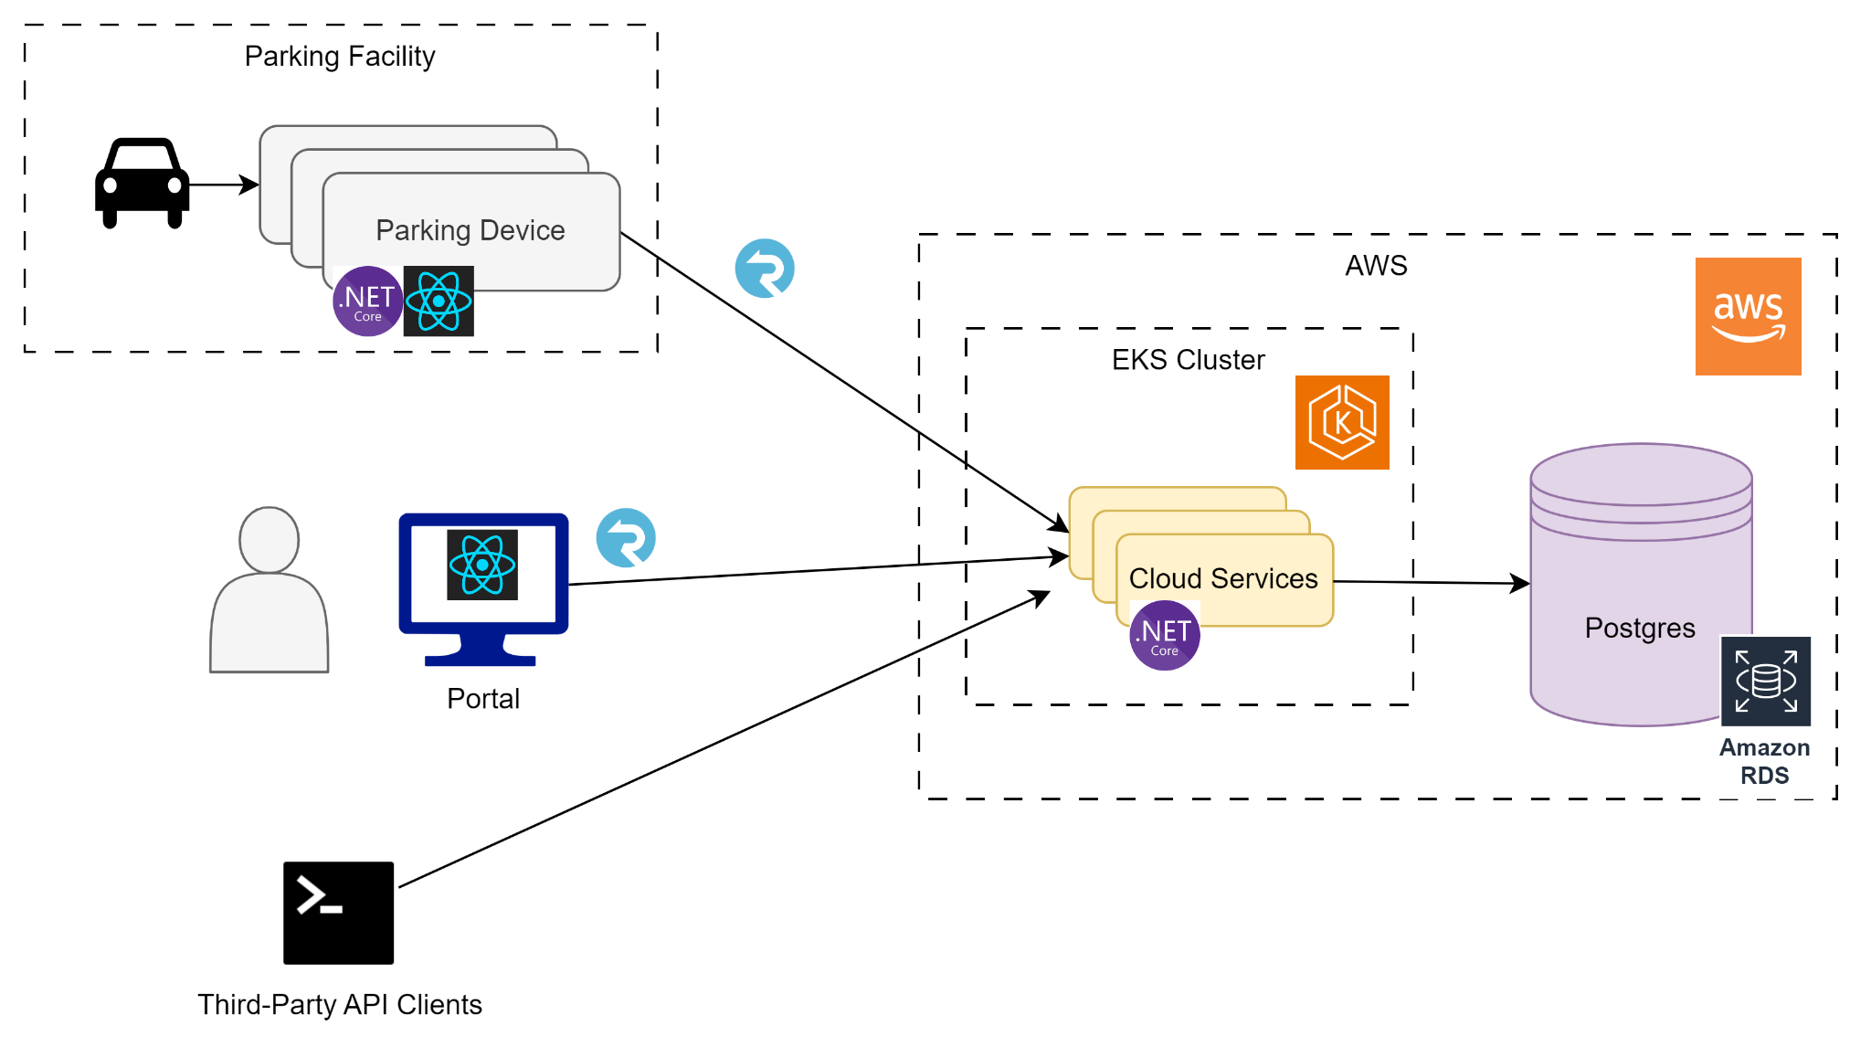
General Architecture

Slide 6
Cloud Architecture

Slide 7
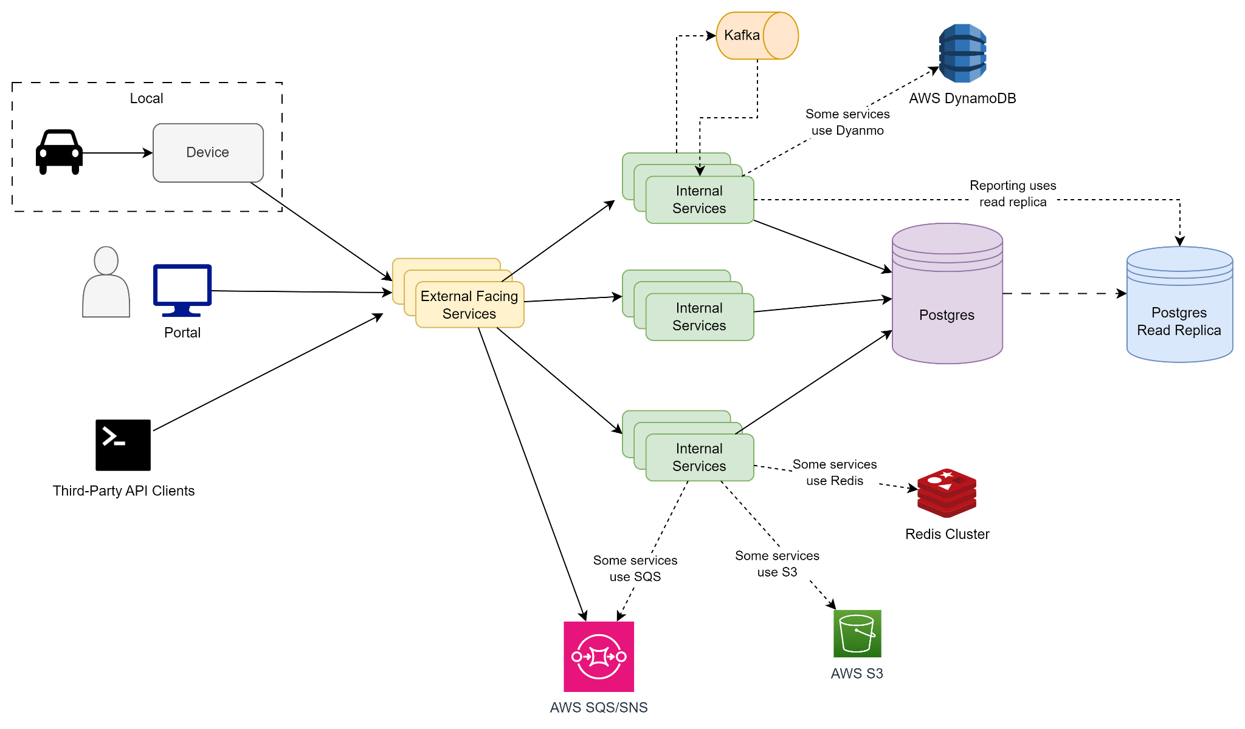
Detailed Architecture

Slide 8
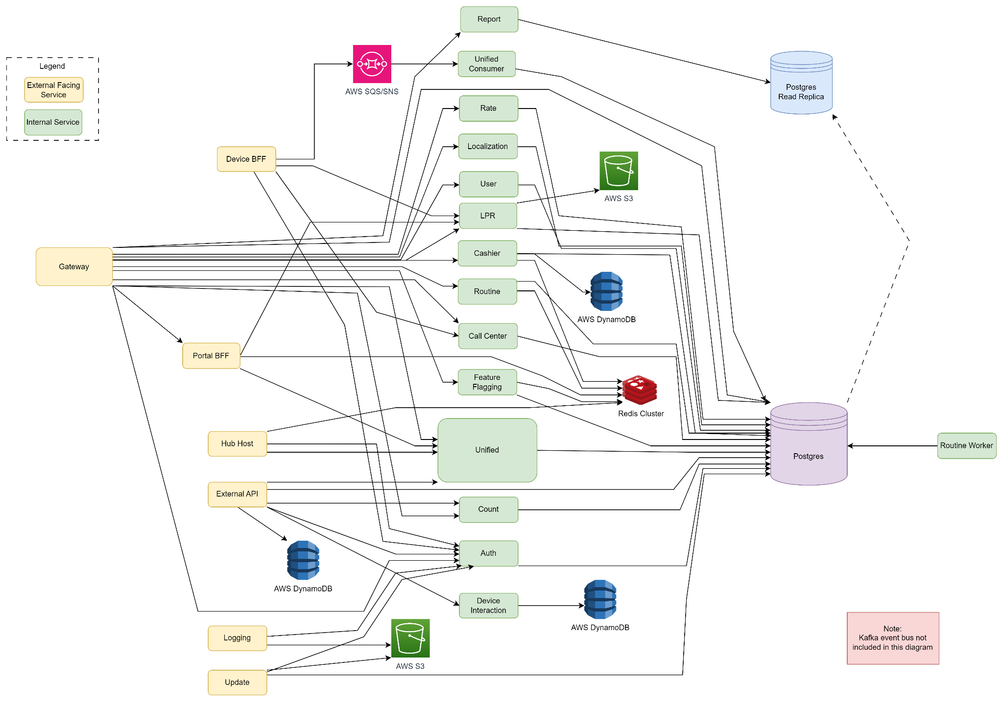

Full Cloud Architecture (microservice hell)

Slide 9
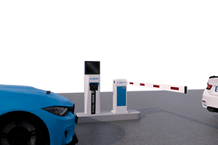
Device Architecture

Slide 10
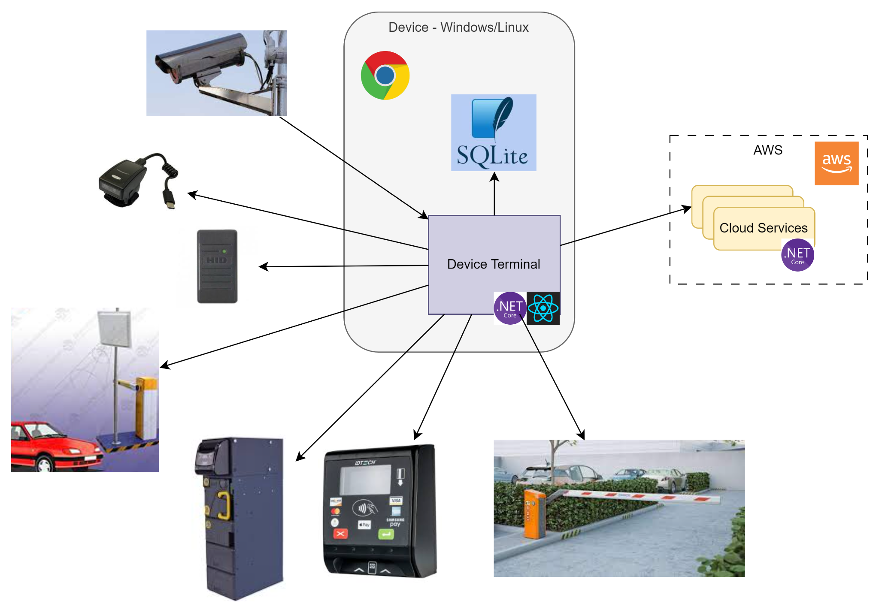
Device Architecture

Slide 11
Device Development Experience

Slide 12


Device Architecture
“Bare Metal”
“Edge”

Slide 13
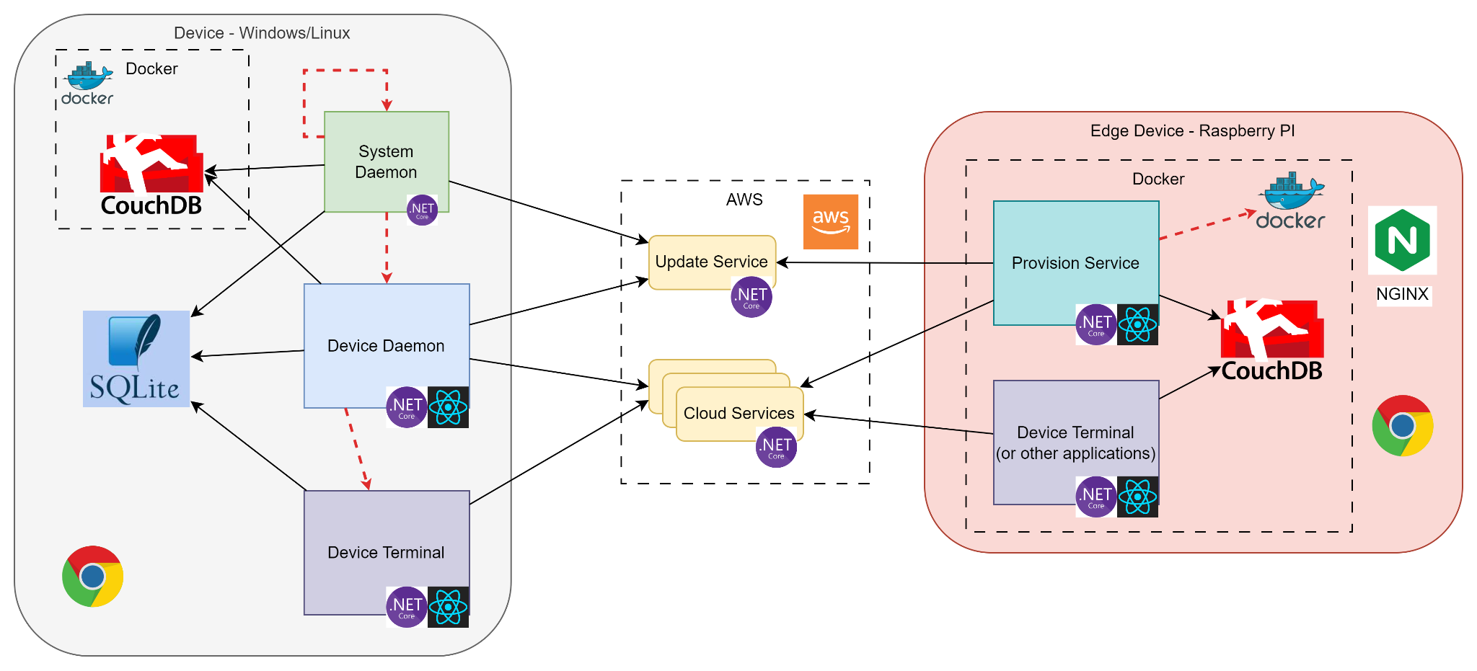
Device Architecture
“Bare Metal”
“Edge”

Slide 14

Deployments

Slide 15
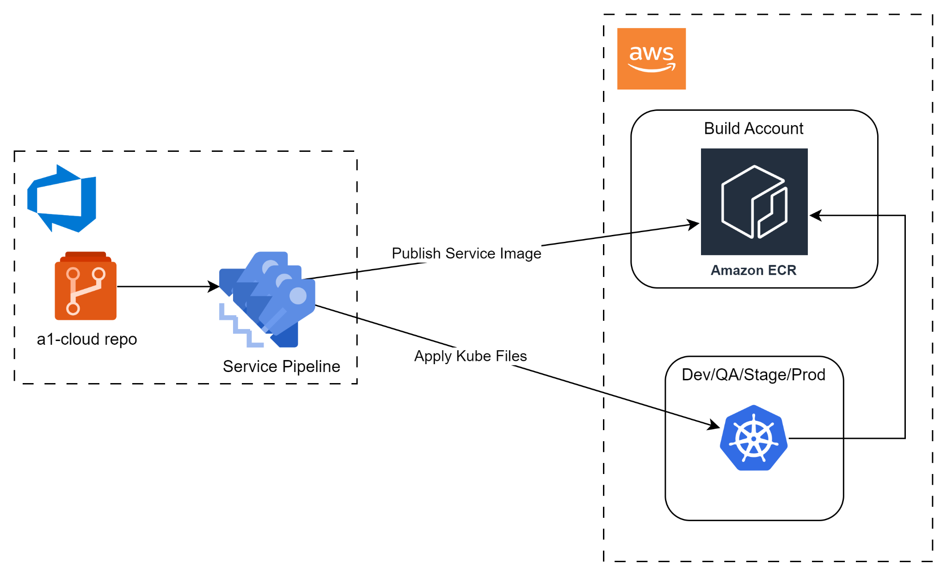
Deployments - Cloud

Slide 16
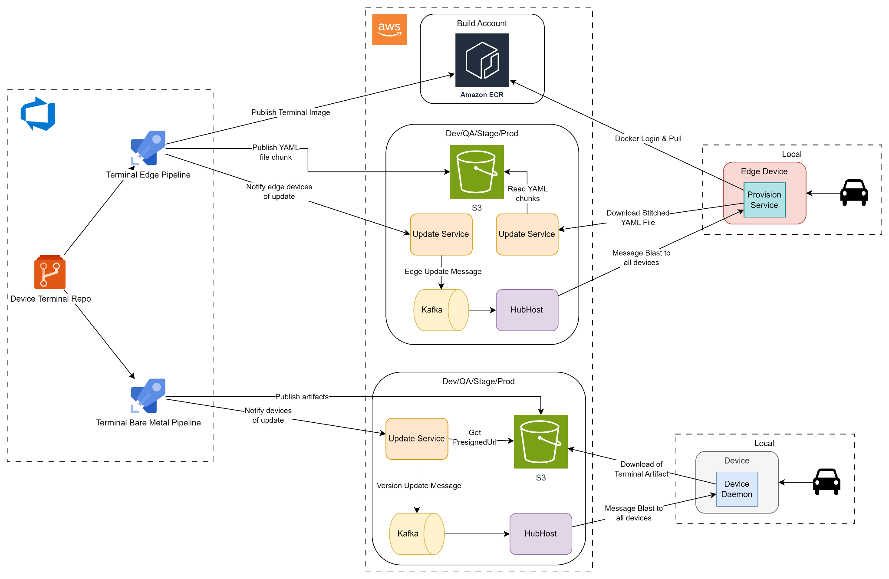
Deployments

Slide 17
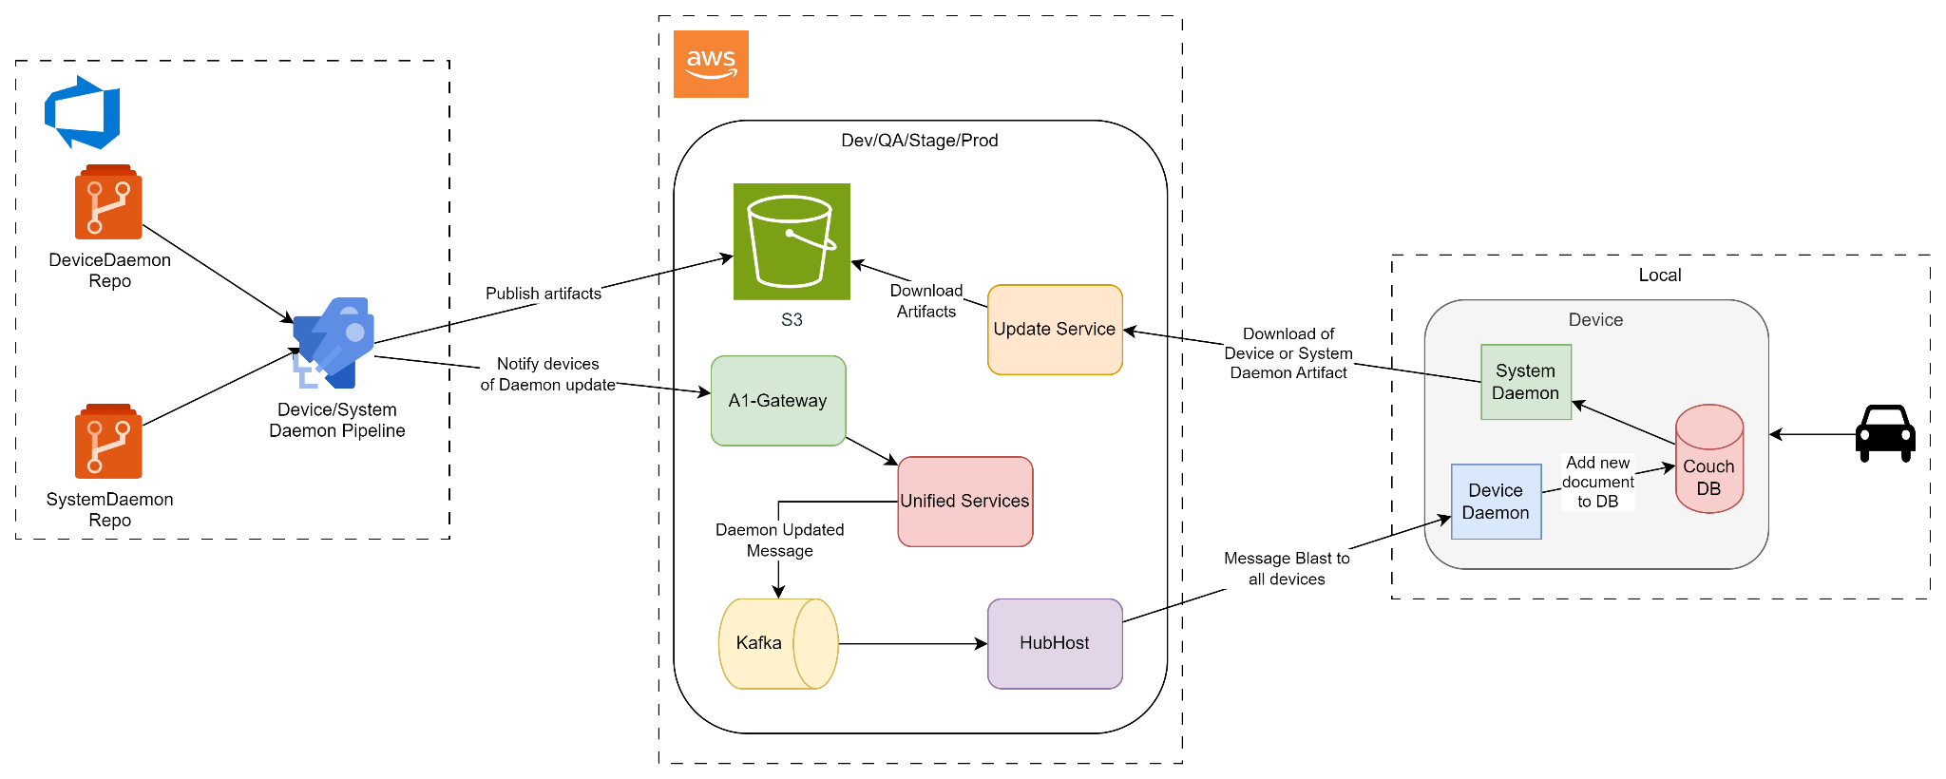
Deployments - Bare Metal Daemons

Slide 18

Issues

Slide 19

Issue 1 - Thread pool exhaustion & SQL timeouts
Rapid message ingress
Long running SQL queries
No way of cancelling long requests

Slide 20

Issue 1 - Solution
Process messages one at a time
Add cancellation tokens to endpoints with longer expected queries
Separate some API requests to hit DB replica

Slide 21

Issue 2 - Data Loss
Errors occurring during message consumption would lead to losing the message entirely
Messages could get lost during transmission to cloud services
Especially bad when messages include payments

Slide 22

Issue 2 - Solution
Converted critical messages to go through AWS SQS to enable message retries and DLQs
Transmission of device messages switched from SignalR to HTTP calls
Messages between services switched to using the Outbox pattern

Slide 23

Issue 3 - Team Structure

Slide 24

Issue 3 - Team Structure
Notes:
Conway's law describes the link between communication structure of organizations to the systems they design. It is named after the computer programmer Melvin Conway, who introduced the idea in 1967.
His original wording was:
Organizations which design systems (in the broad sense used here) are constrained to produce designs which are copies of the communication structures of these organizations.
— Melvin E. Conway, How Do Committees Invent?

Slide 25

Issue 3 - Team Structure

Slide 26
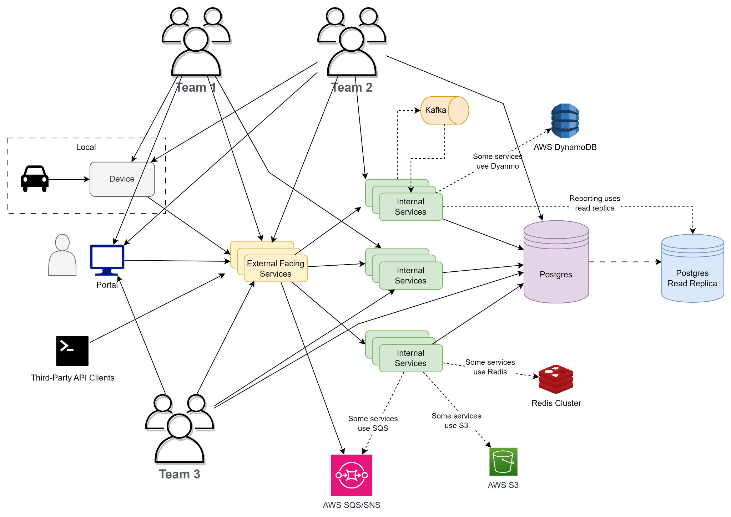
Issue 3 - Team Structure

Slide 27
Issue 3 - Team Structure
No one with a solid grasp on any particular areas of the system
New features take lots of grooming and planning to determine correct approach
Development time increased because developers have to learn/relearn parts of the system
Notes:
Independent “Feature” teams

Slide 28

Issue 3 - Solution?
Notes:
Proposed:
restructure the teams
Isolated teams on specific pieces
Shift in architecture

Slide 29
Lessons Learned
Don’t leave long running requests open when they are abandoned by the client
Ensure data resilience for business critical data
When architecting a solution, be sure to account for how the teams are structured
BONUS: Don’t build when you can buy

Slide 30

Thanks
Any Questions?

